Slide 1
Review Lesson: (review Lesson, not a new lesson)
1. Review vocabularies:
Draw a diagram in one circle on the whiteboard for the following key terms (5 minutes):
(Students will show me their diagrams on the whiteboards, and I will give them feedback. For the whole class or just for the EL Learner? This is the requirement for the project)
A Radius
Diameter
A Chord Can you draw 2 chords intersect inside the circle?
Secant line
Tangent line
Central angle
Inscribed angle
Arc of a circle

Slide 3
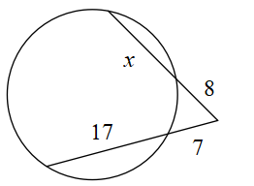



















Example 1. Find x value:

Slide 4
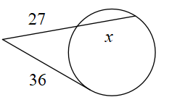







































Example 2.
(Do with the students)
outside (whole) = outside (whole)
OW = OW

Slide 5
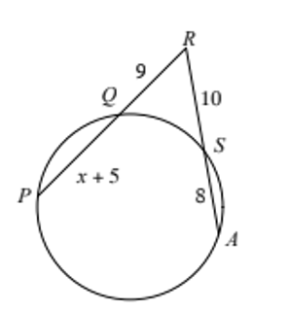
Example 3:

Slide 6
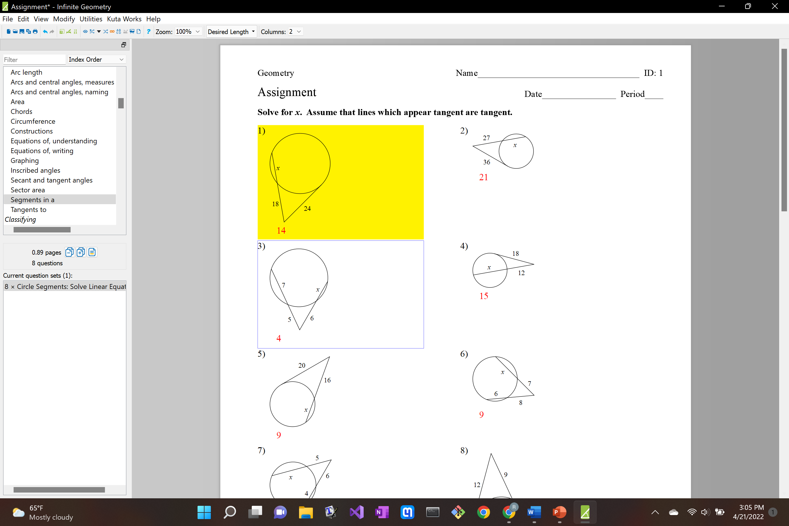
Example 2: (Let the students do, then I will explain it)
(outside)(whole)=(outside)(whole)
(OW) =(OW)
5 (5+7) = 6 (6+x)
25 + 35 = 36 + (6x)
60= 36 + 6x
-36 -36
24 = 6 x
__ __
6
4 = x

Slide 7
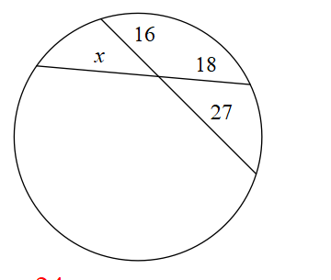
Example 3. Find x value:

Slide 8
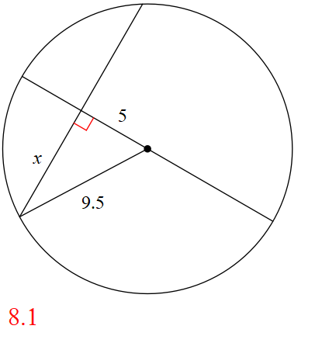
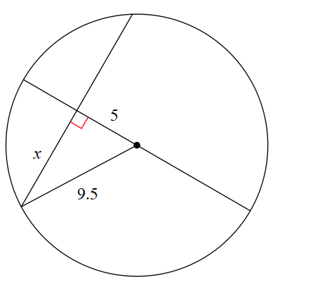
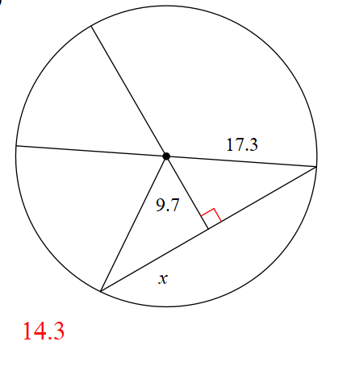
Example 1. Find x value:

Slide 9
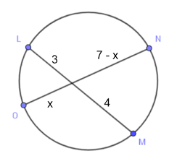

Slide 10



Slide 12

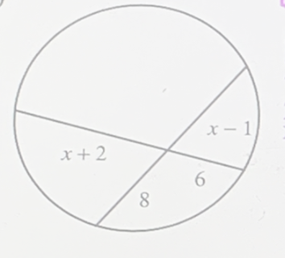

Slide 13
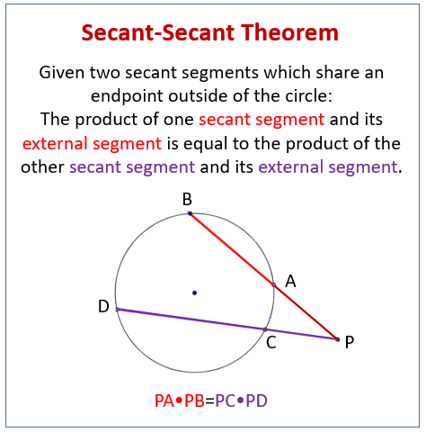
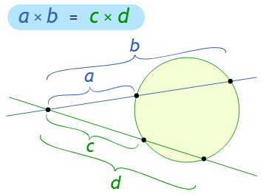

Slide 14
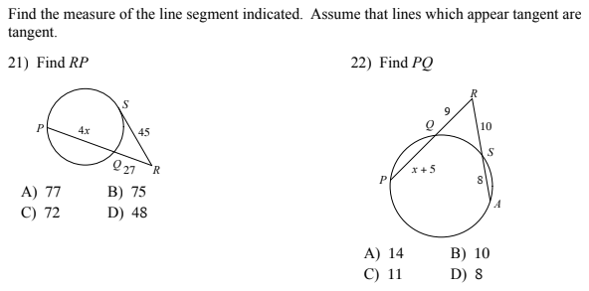

Slide 15
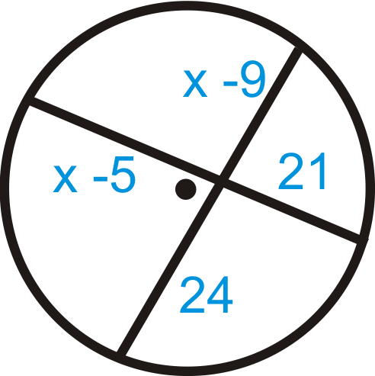

Slide 16
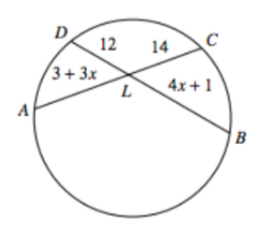
Find CA

Slide 17
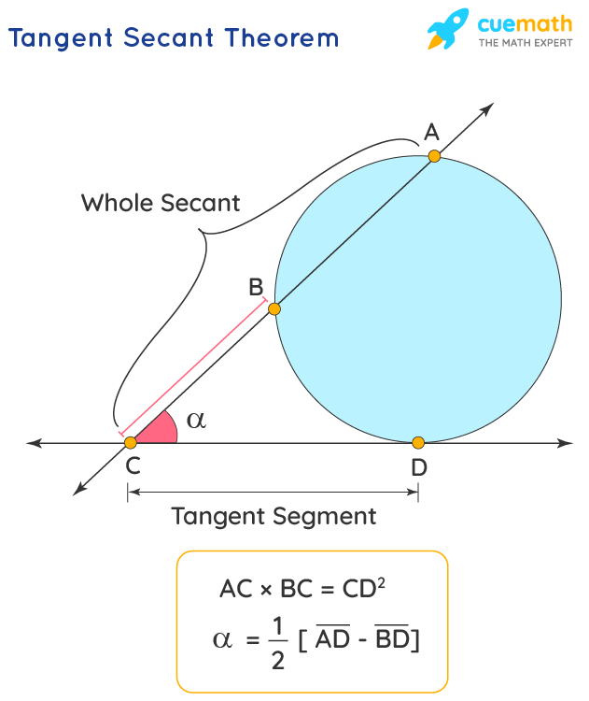

Slide 18
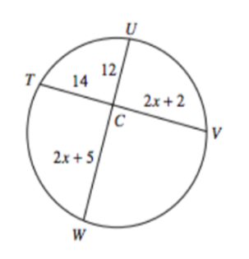

Slide 19
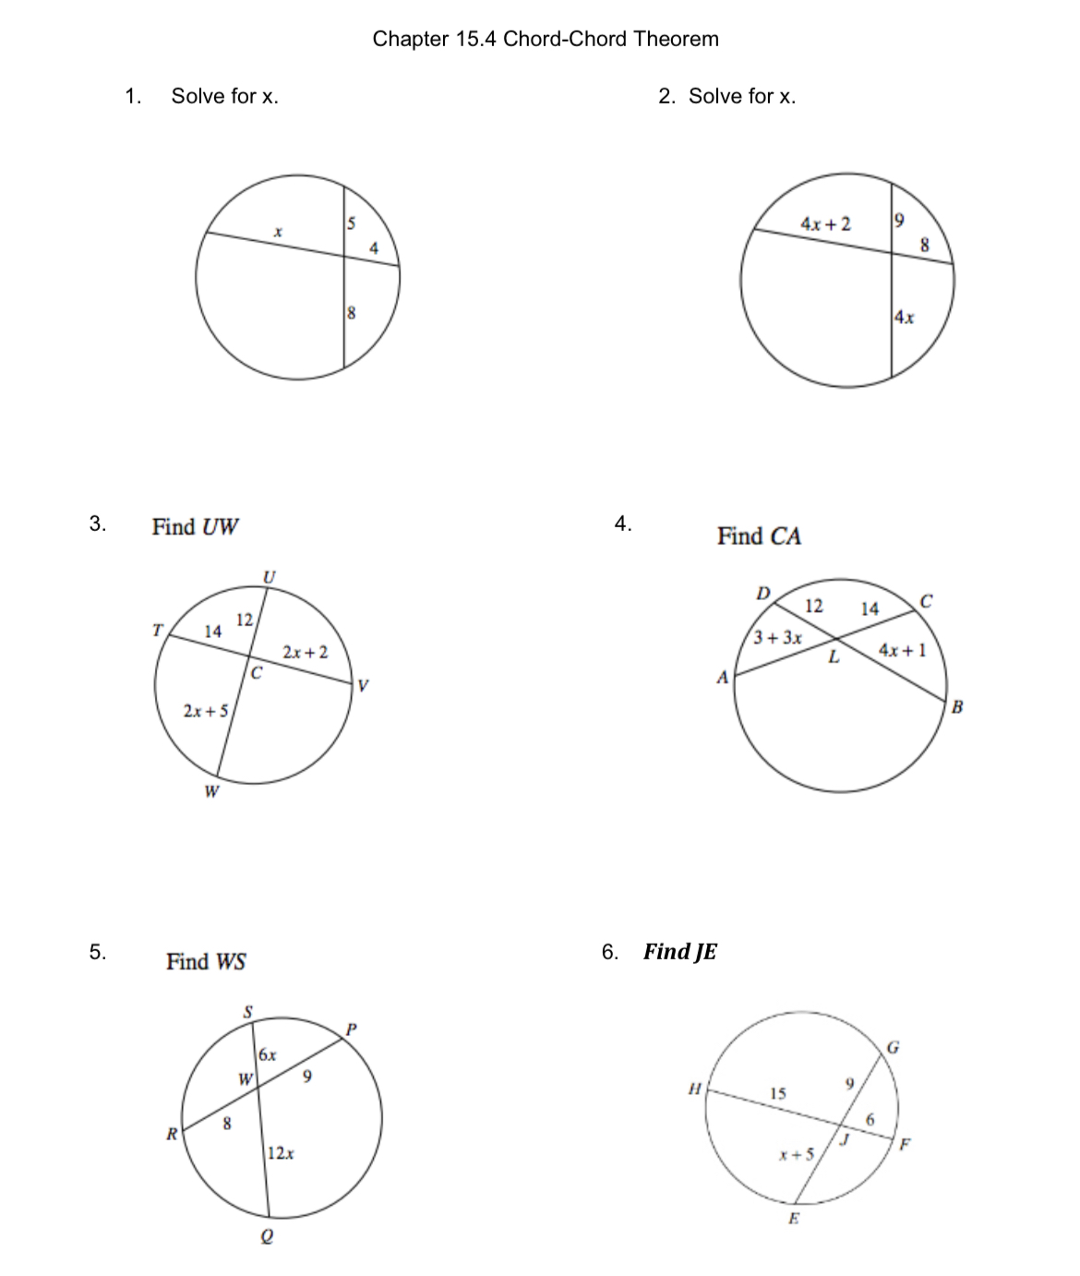

Slide 27
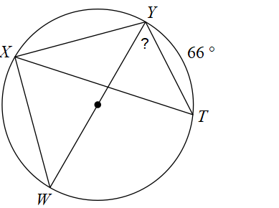
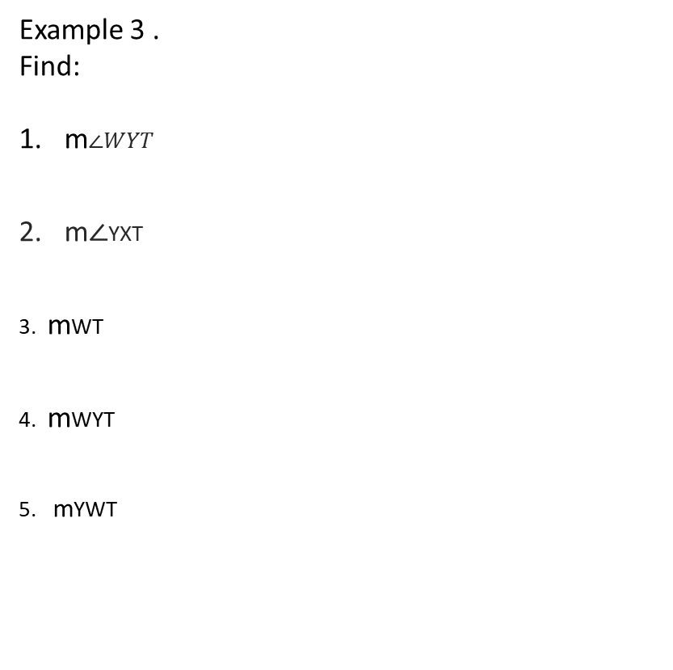
Example 3 .
Find:
m$∠WYT$
m$∠$YXT
3. mWT
4. mWYT
5. mYWT

Slide 29

December Holidays Around the World
Few months present as many multicultural celebrations as December. From Christmas to Omisoka, the last month of the year is a “world of holidays.” Let’s take a look at some of December’s holidays around the world.

Slide 30


Slide 31


Slide 32
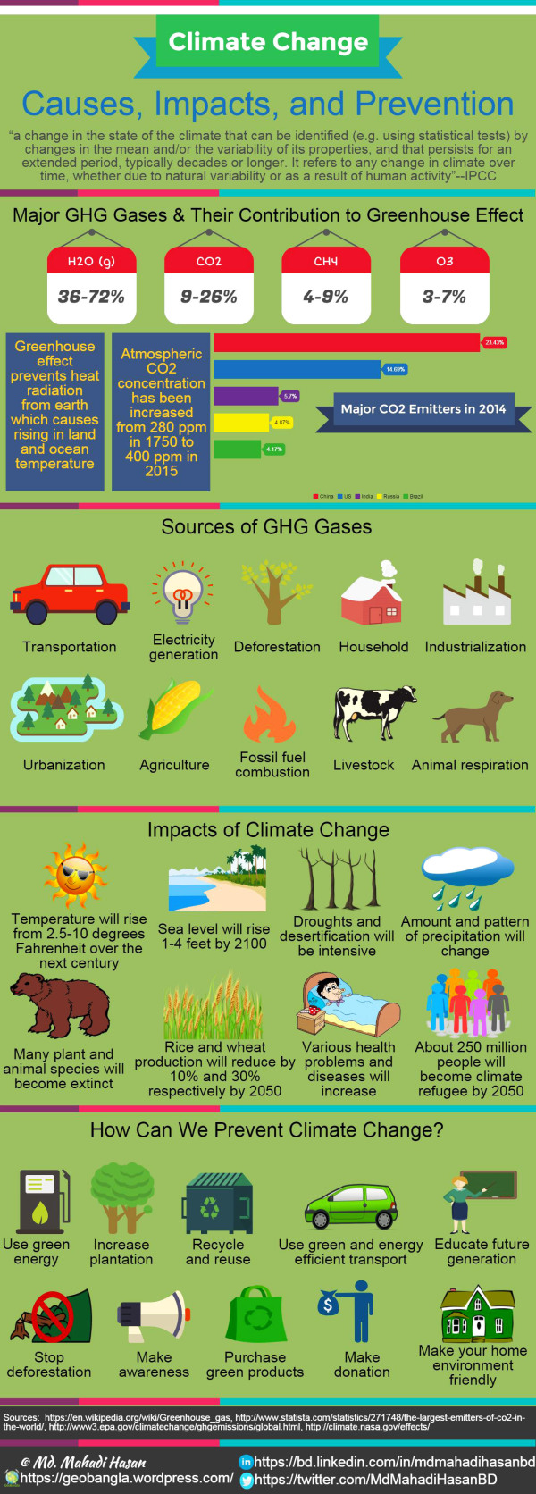

Slide 34
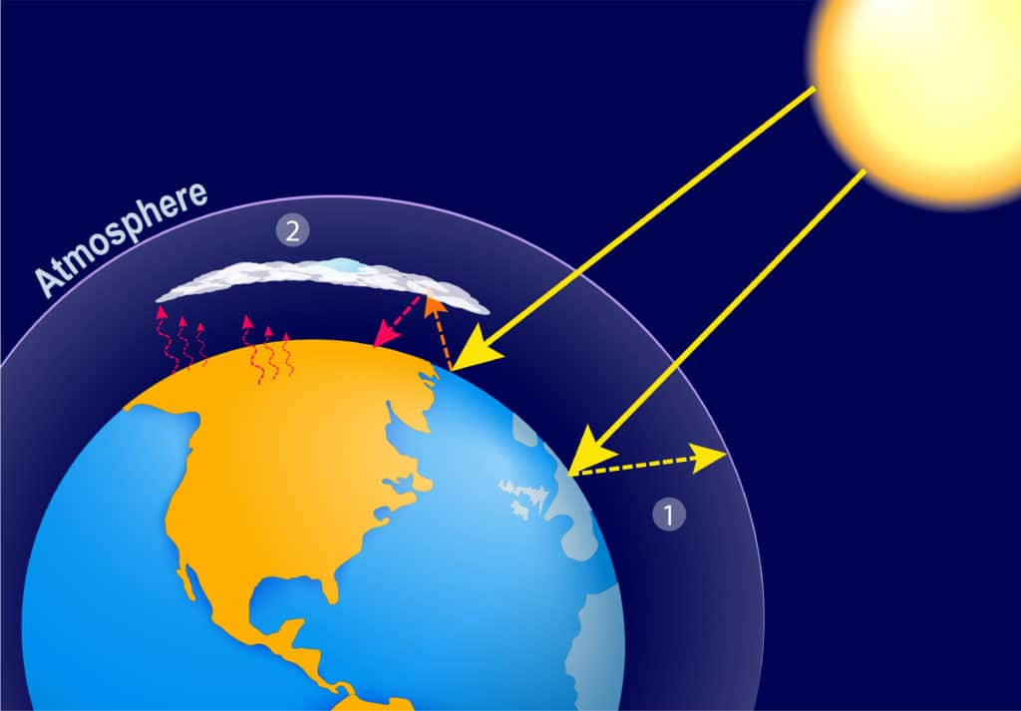

Slide 35
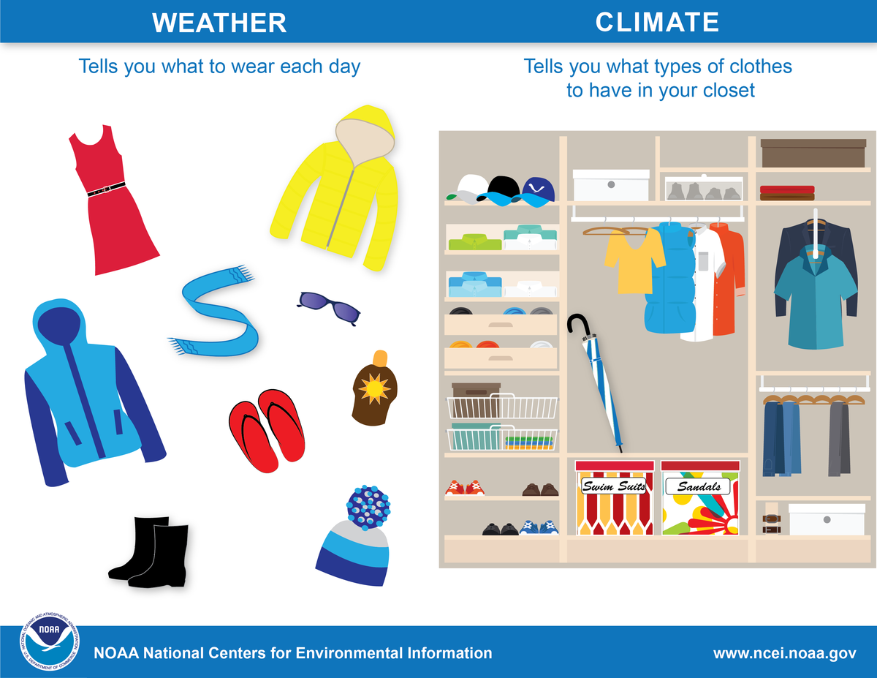

Slide 36
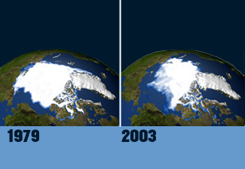

Slide 37


Slide 38


Slide 39
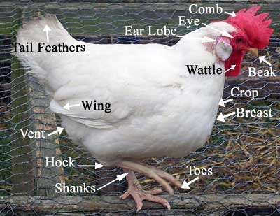

Slide 40


Slide 41
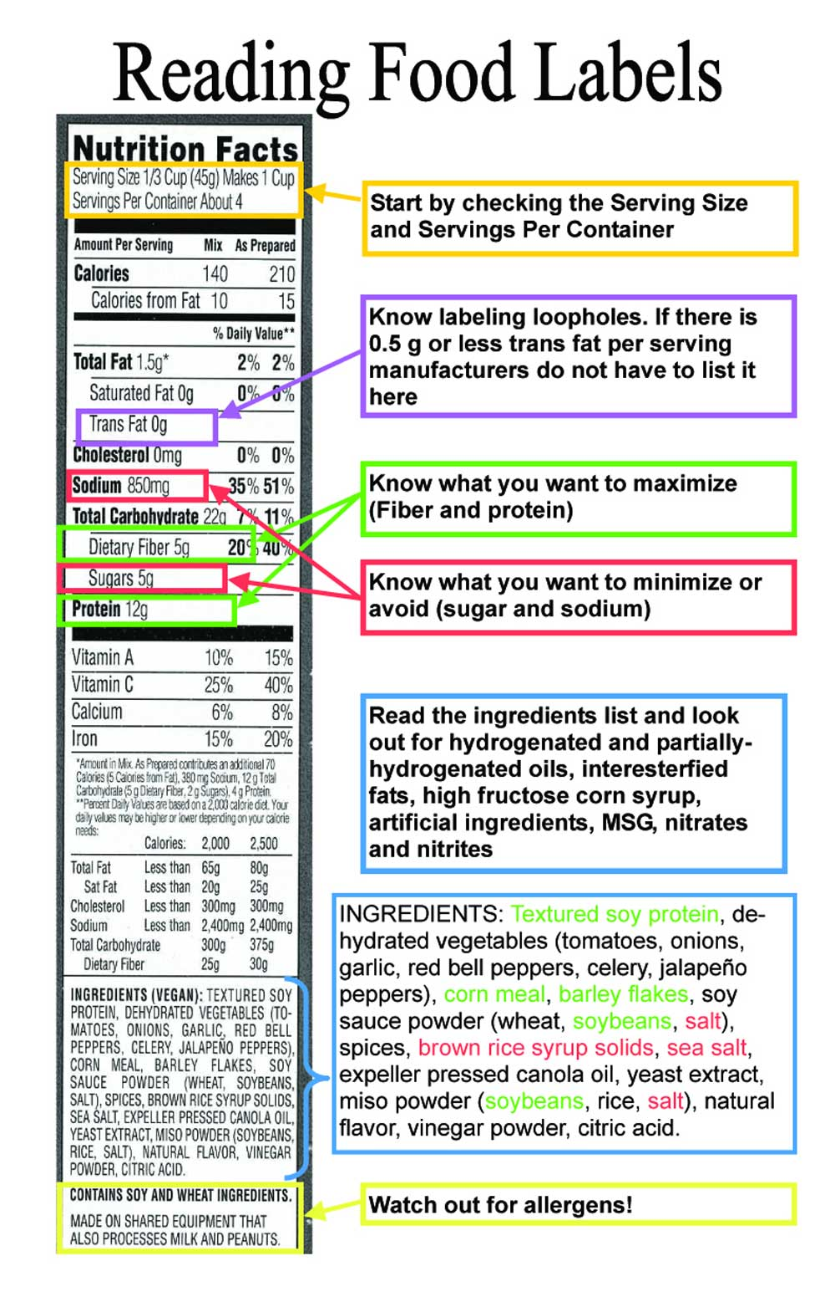

Slide 42


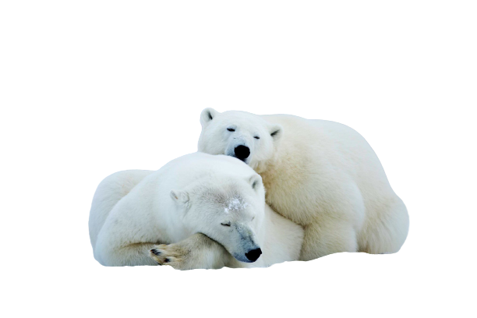



Slide 43


 | Travel back in time to dinosaur times. But did you know that not all dinosaurs lived at the same time? Use the clues to put the dinosaurs into the correct periods on our time line! The Flash plug-in is required to play this game. If you don't have it, click here to download it for free.
 | This information will help you figure out when each dinosaur lived. Read carefully for clues!
 | The earliest dinosaurs and mammals date back to the late Triassic period, about 225 million years ago. Most of the first Triassic dinosaurs were small and quick meat-eaters that walked on their hind legs. By the end of the Triassic period (about 200 million years ago), larger prosauropods (20-foot-long plant-eating dinosaurs) were beginning to appear.
 | The Jurassic period began about 200 million years ago and lasted about 55 million years. Many new types of dinosaurs, mammals, and reptiles emerged during the Jurassic, including the plated dinosaurs and the sauropods — heavy, long-necked dinosaurs that walked on four legs. There were also large theropods, or meat-eating dinosaurs, roaming the Earth. The first birds (and bird-like dinosaurs) also appeared during the Jurassic period.
 | The Cretaceous period began about 145 million years ago and ended 65 million years ago with the extinction of the dinosaurs. Flowering plants and modern insects appeared. Dinosaurs of all shapes and sizes walked the land, including duckbills, armored, horned, and dome-headed dinosaurs. There were new forms of giant meat-eaters, as well as a deadly new breed of hunter, the "raptor" dinosaur, known for its sharp teeth and curved claw on each hand and foot.

Slide 44
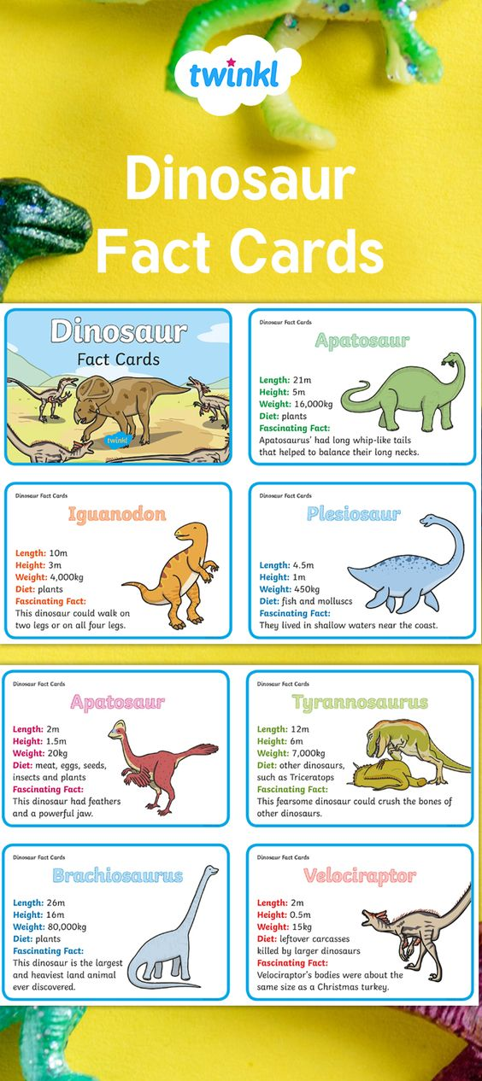

Slide 45
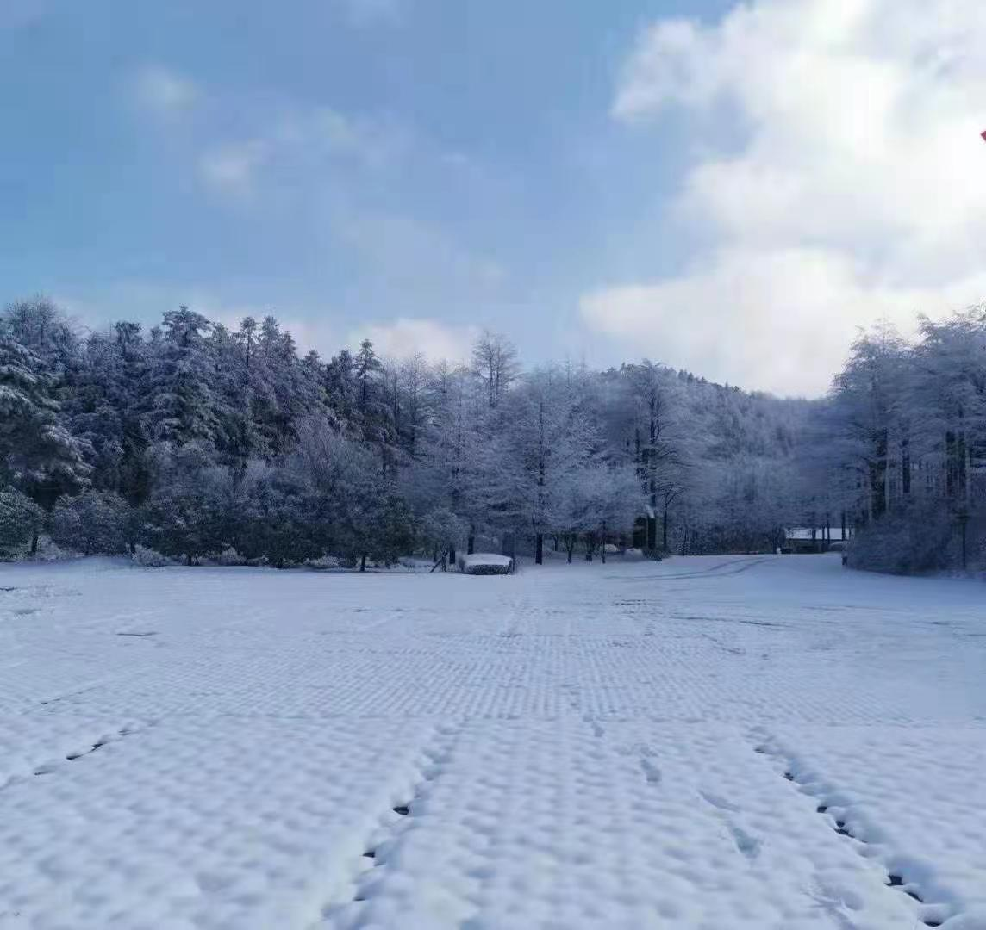

Slide 46


Human & Nature Are Supposed to Be Together

Slide 47


Slide 48
Bon jour
Hello

Slide 49
Joyeux Noel
Merry Christmas

Slide 50
Letter to Pere Noel
Letter to Santa Claus

Slide 51


Slide 52


Slide 53
Fete des Lumieves
festival of lights

Slide 54


Slide 55
Les Marches de Noel -
Christmas marches

Slide 56


Slide 57
les Treize Desserts de Noel
the thirteen Christmas desserts

Slide 58


Slide 59
Questions: How are French Christmas holidays different from ours?
Is there a law in the United States stating that post office must write a letter to each child who writes a letter to Santa Claus telling them their letters were delivered?
2. Do we must have thirteen deserts for Christmas diner?

Slide 60
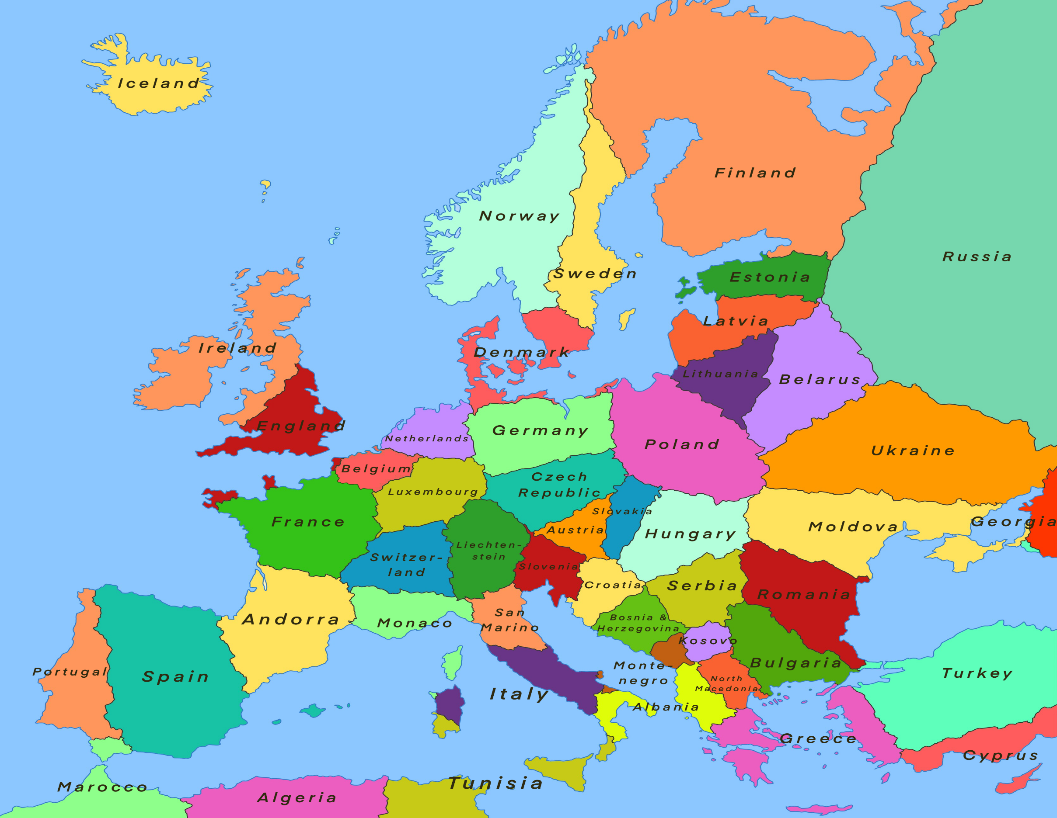

Slide 61
Do you know how big is France?
Area: 248,573 mi²
Population: 66.99 million (2019)
California:
Area: 163,696 mi²
Population: 39.51 million
(2019)

Slide 62
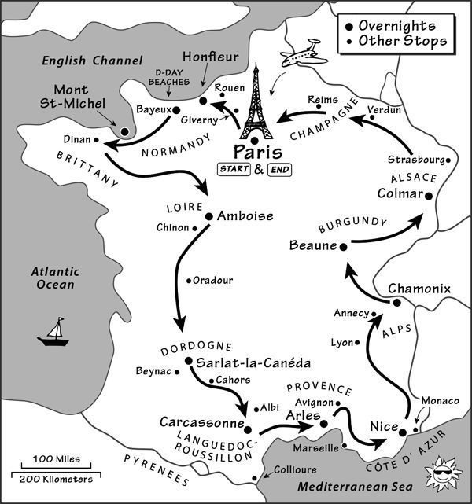

Slide 63
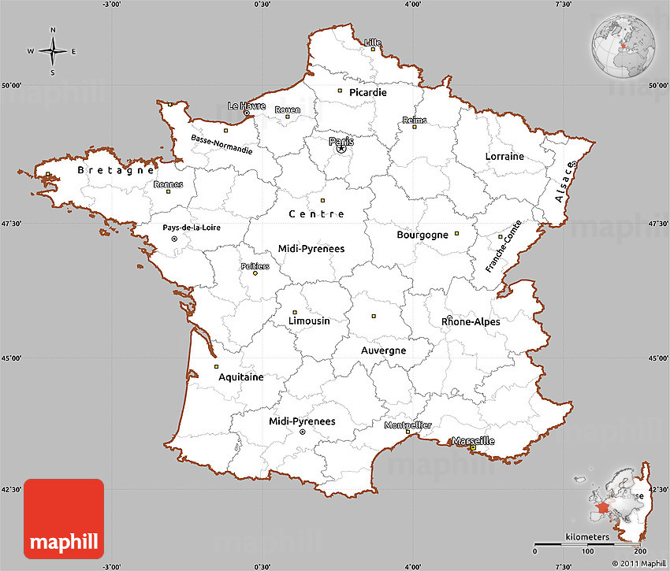

Slide 64
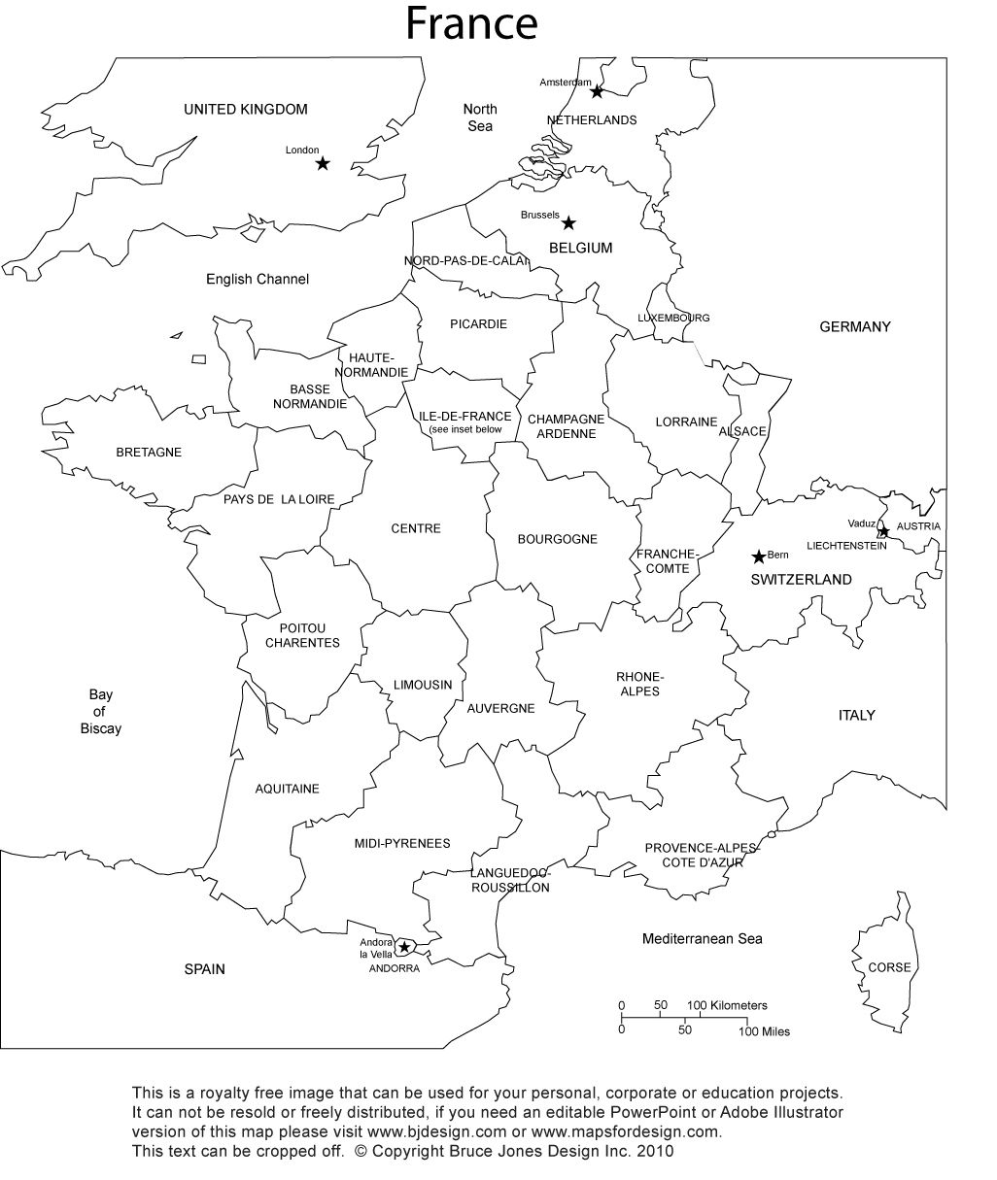

Slide 65



Slide 76


Slide 77
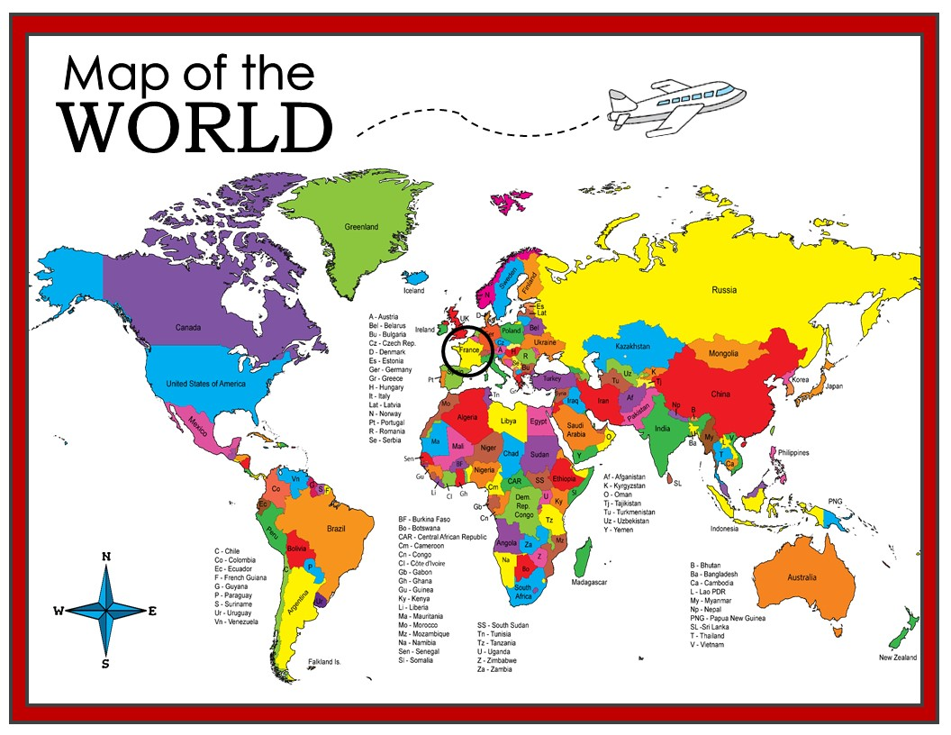

Slide 79


Slide 80


Slide 81


Slide 82


Slide 83


Slide 84


Slide 85
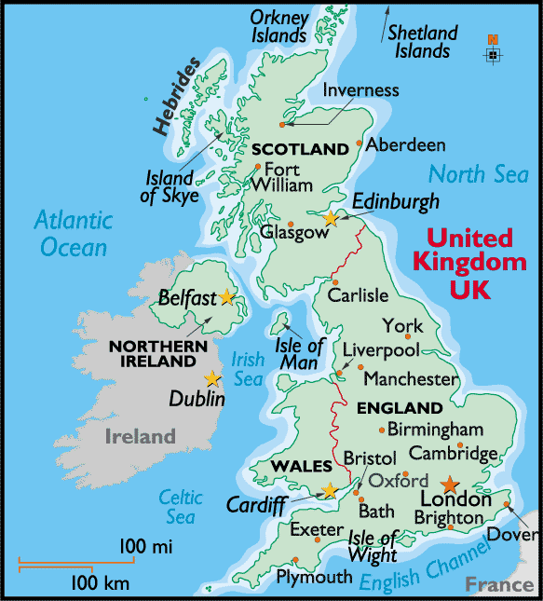

Slide 86
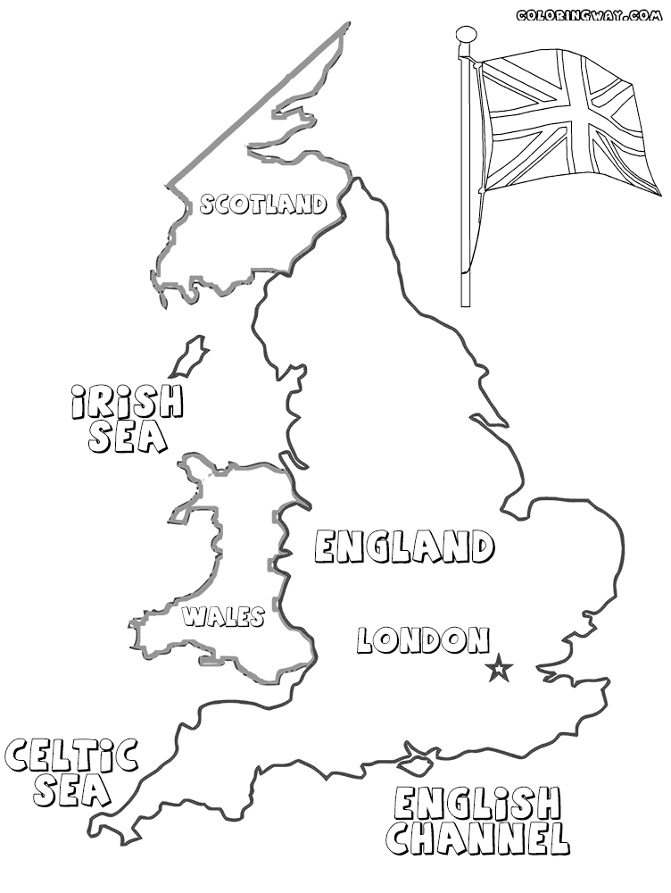

Slide 87



















Slide 88


Slide 89


Slide 90


Slide 91


Slide 92
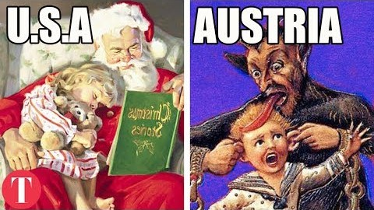

Slide 94


Slide 95


Slide 96


Slide 97


Slide 98


Slide 99


Slide 100


Slide 101


Slide 102


Slide 103


Slide 104

How big is United Kingdom comparing to the United States?

Slide 105
How big is United Kingdom comparing to the United States?

Slide 107
United States is about 28 times bigger than Germany.
Meanwhile, the population of Germany is ~80.2 million people (300 million more people live in United States).

Slide 108
Guten Tag / gu’en tag/: Good Day
Weinachtsmann/ ‘winasmen/:
Santa Claus
Frohe Weihnachten /’fru:hu:/:
Merry Christmas

Slide 109


Slide 110


Slide 111


Slide 112


Slide 113


Slide 114


Slide 115


Slide 116


Slide 117


Slide 119


Slide 120


Slide 121


Slide 122
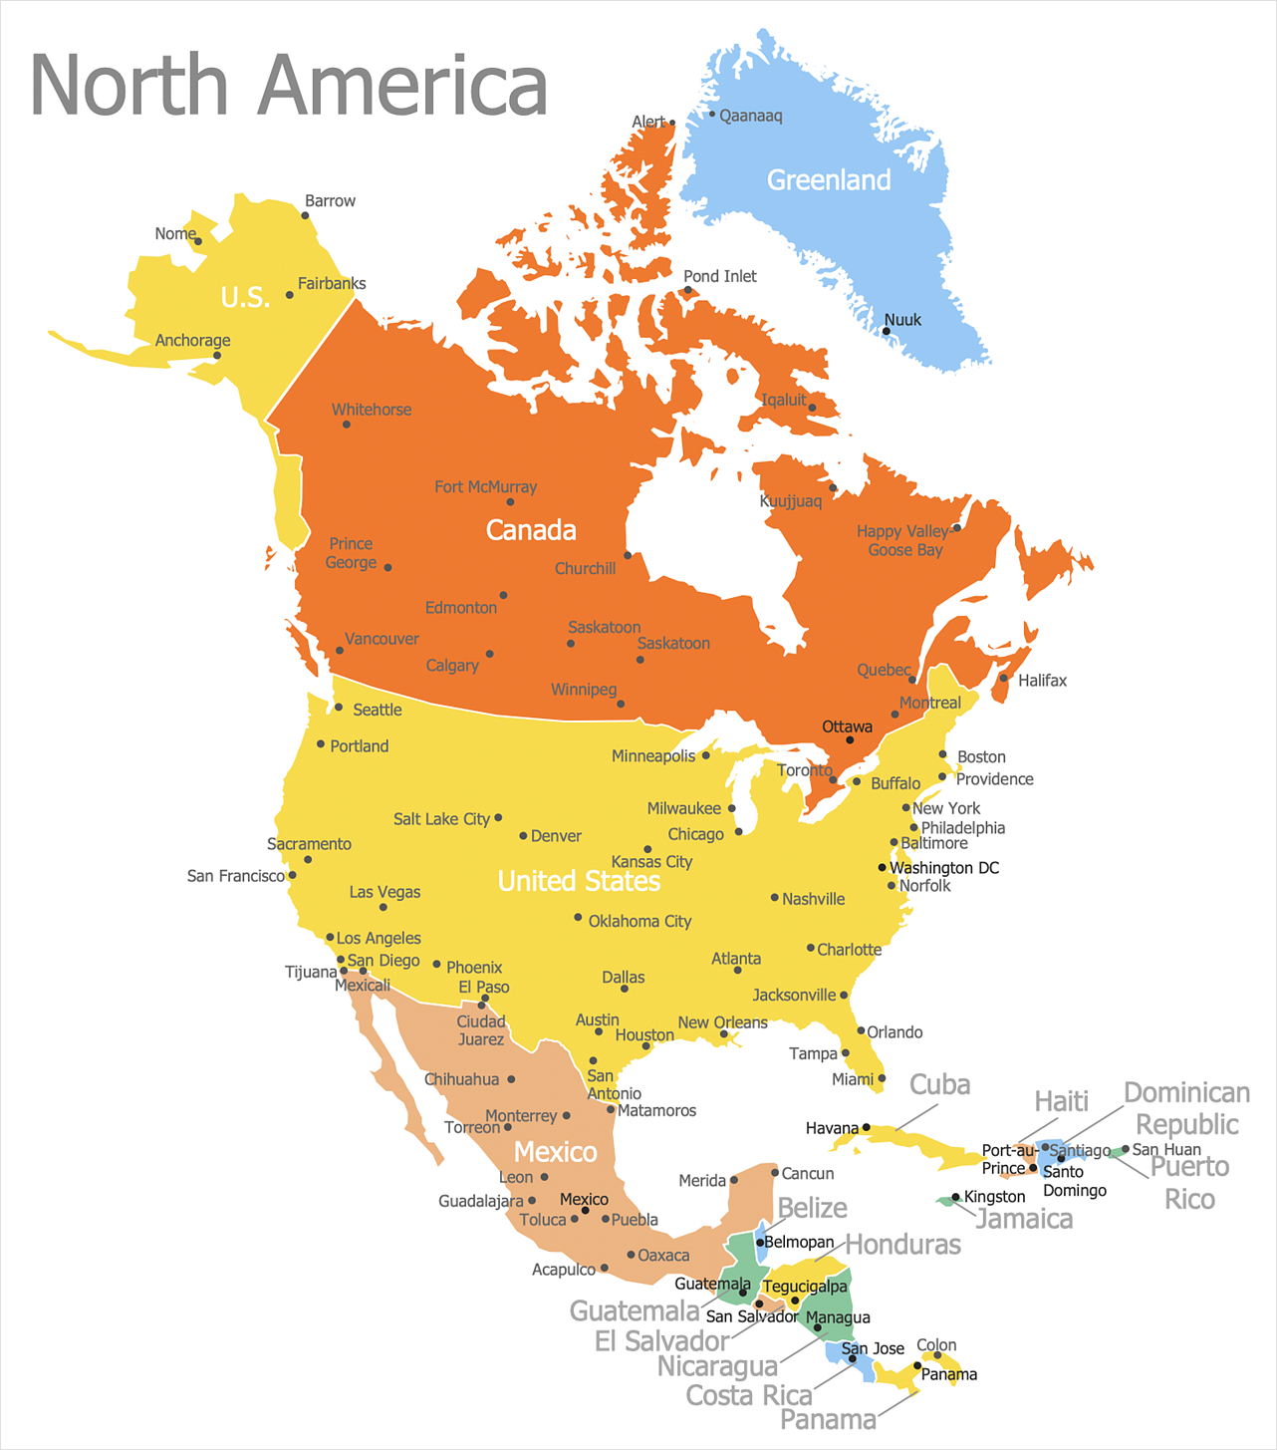

Slide 123
United States is about 5 times bigger than Mexico
Meanwhile, the population of Mexico is ~128 million people (300 million people live in United States)

Slide 124


Slide 125


Slide 126


Slide 127


Slide 128
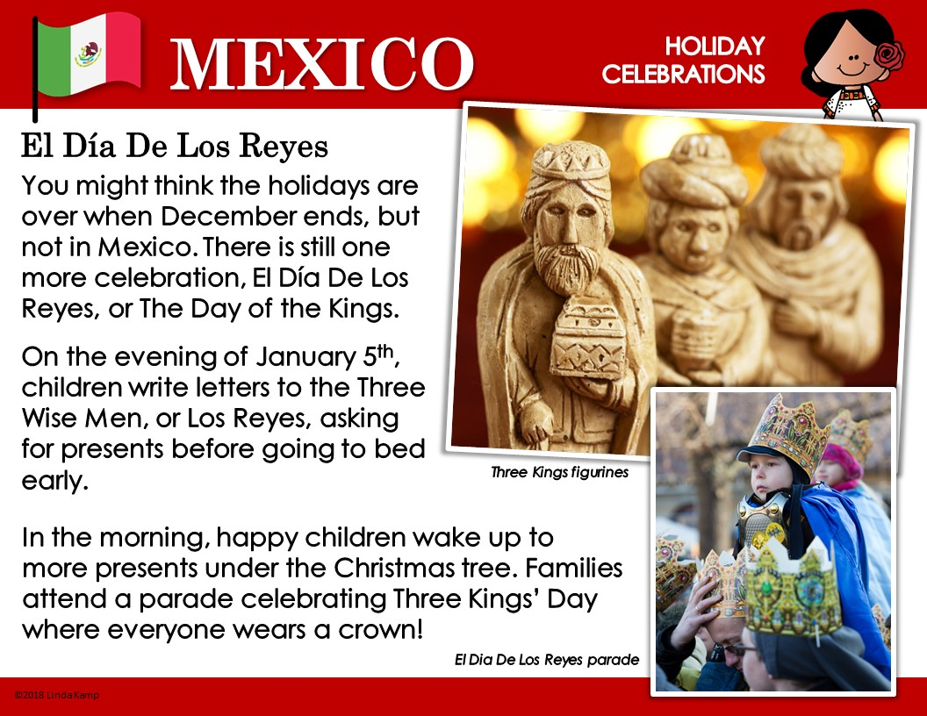

Slide 129
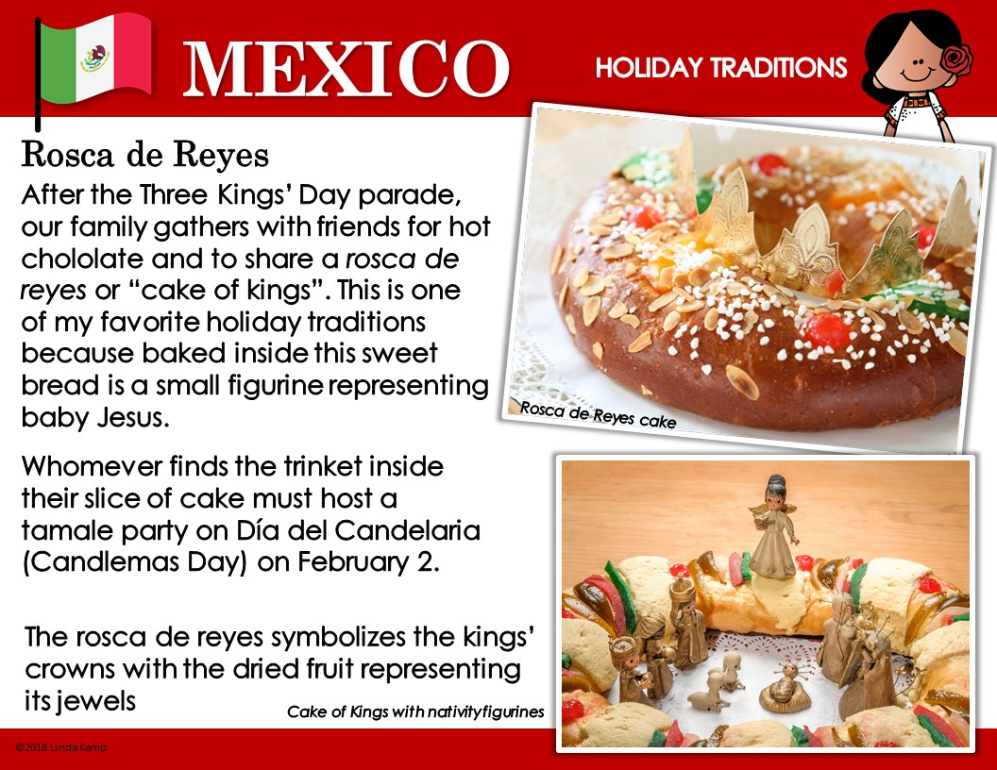

Slide 130


Slide 131

https://youtu.be/rQnkdAExoyo

Slide 132


Slide 133


Slide 134


Slide 135


Slide 136


Slide 137



Slide 138


Slide 139


Slide 140


Slide 141


Slide 142

Happy Chinese New Year to Everyone!
May you continue to stay safe and keep health
Happiness will be with you through the year!!

Slide 143



Slide 145


Slide 146


Slide 147


Slide 148


Slide 149


Slide 150


Slide 151
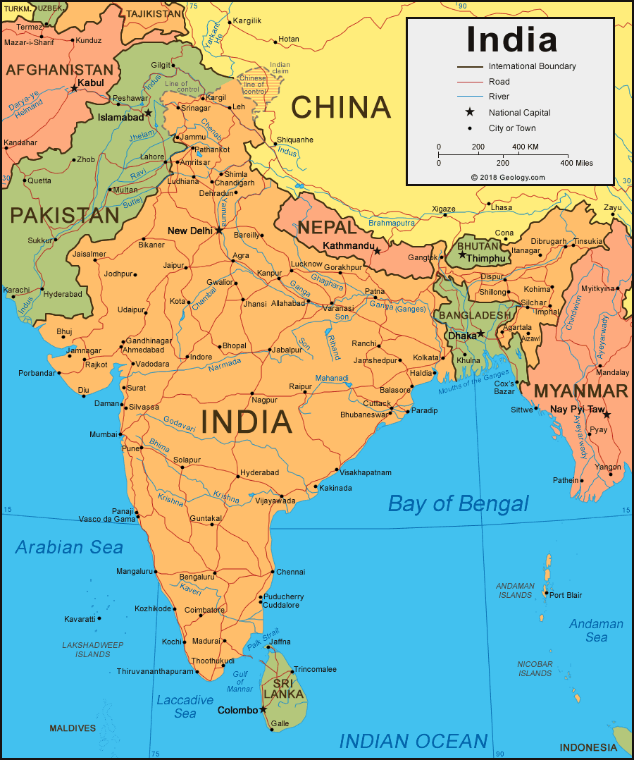

Slide 152


United States is about 3 times bigger than India.
Meanwhile, the population of India is ~1.3 billion people (993.5 million fewer people live in United States).

Slide 153
Diwali – Holiday Celebration
Shubh Deepavali – Happy Holiday

Slide 154


Slide 155


Slide 156


Slide 157


Slide 158


Slide 159


Slide 160


Slide 161

https://youtu.be/HrrW3rO51ak

Slide 162


Slide 163


Slide 164


Slide 165


Slide 166
United States is about 448 times bigger than Israel.
Israel is approximately 21,937 sq km, while United States is approximately 9,833,517 sq km, making United States 44,726% larger than Israel. Meanwhile, the population of Israel is ~8.7 million people (324.0 million more people live in United States).

Slide 167

December 1st, 2020 Monday
United States is about 448 times bigger than Israel.
Meanwhile, the population of Israel is ~8.7 million people (300 million more people live in United States).

Slide 170


Slide 171
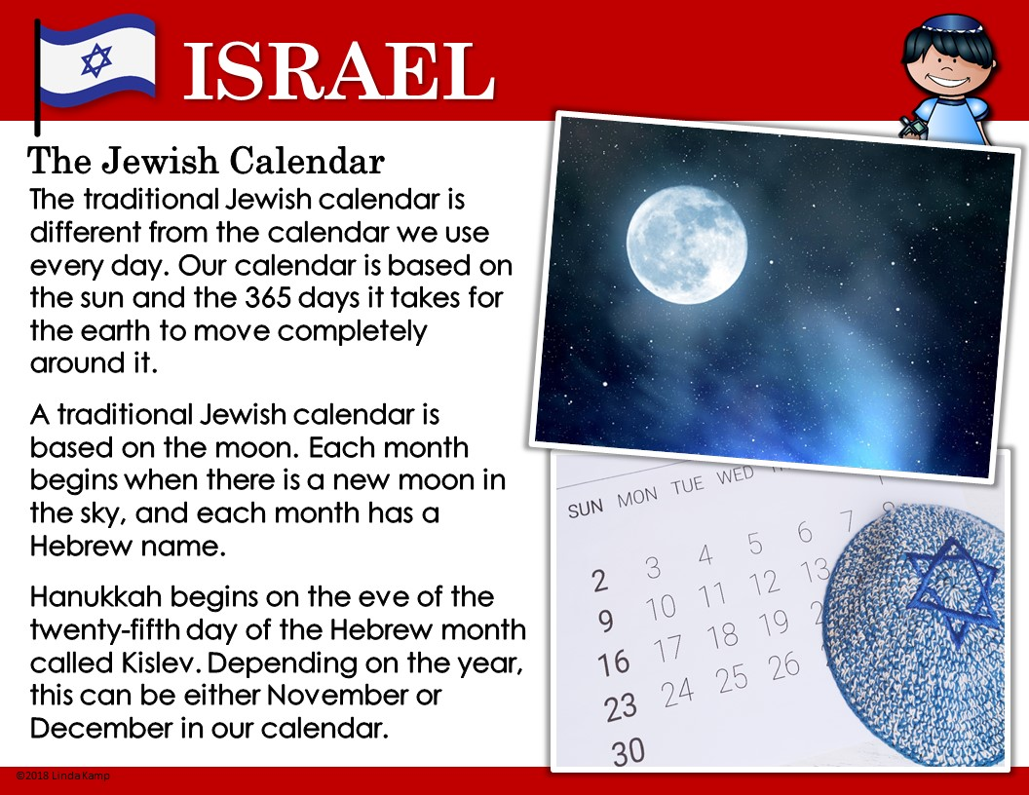

Slide 173


Slide 174


Slide 175


Slide 176


Slide 177


Slide 178


Slide 179


Slide 180


Slide 181


Slide 182


Slide 183


Slide 184


Slide 185


Slide 186


Slide 187


Slide 188


Slide 189


Slide 190


Slide 191


Slide 192


Slide 193


Slide 194


Slide 195


Slide 196


Slide 197


Slide 198


Slide 199


Slide 200


Slide 201


Slide 202


Slide 203


Slide 204


Slide 205


Slide 206


Slide 207
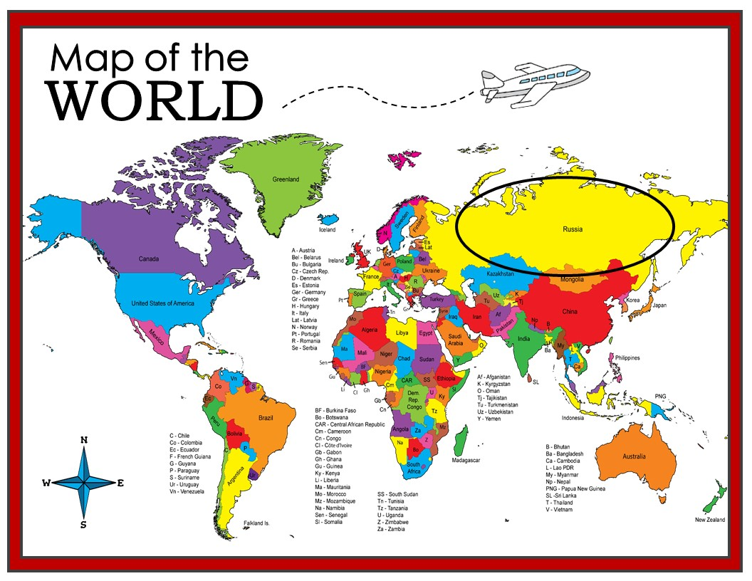

Slide 208


Slide 209


Slide 210


Slide 211


Slide 212


Slide 213


Slide 214


Slide 215


Slide 216


Slide 217


Slide 218


Slide 219


Slide 220


Slide 221


Slide 222


Slide 223


Slide 224


Slide 225


Slide 226


Slide 227


Slide 228
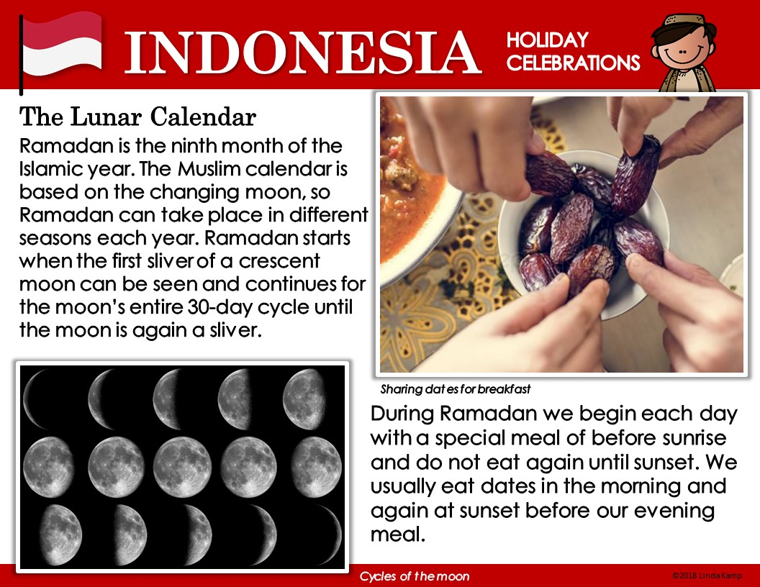

Slide 229


Slide 230


Slide 231


Slide 232


Slide 233


Slide 234
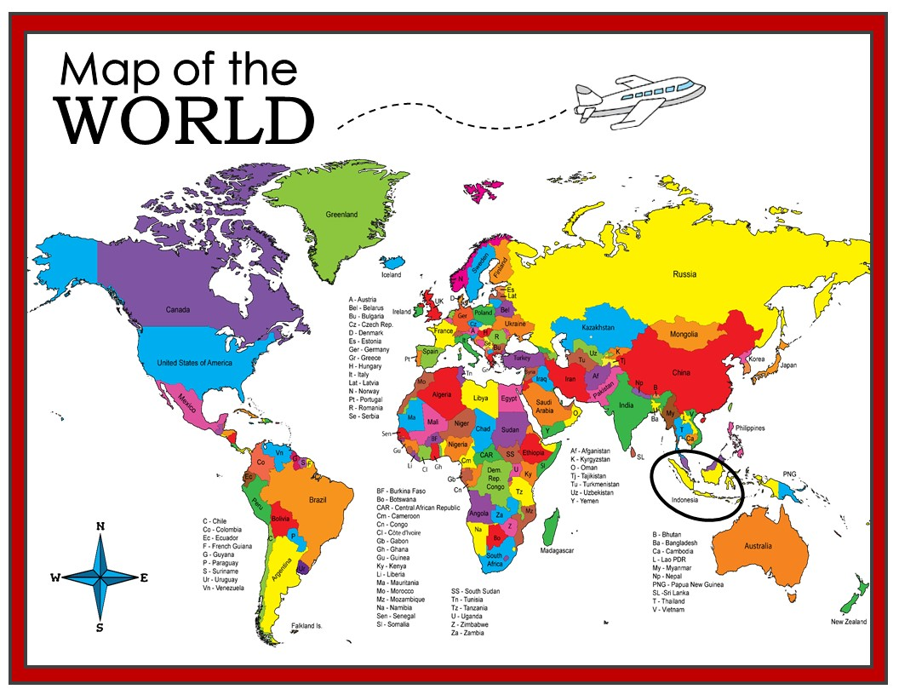

Slide 235


